Slide 1
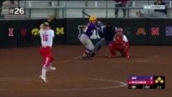
Welcome to the 2021 Idaho State Softball Rules Clinic For Third District

Slide 2
Welcome to the 2021 Idaho State Softball Rules Clinic For Third District

Slide 3
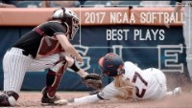
Let’s Play Ball…Walk Up Music Please

Slide 4
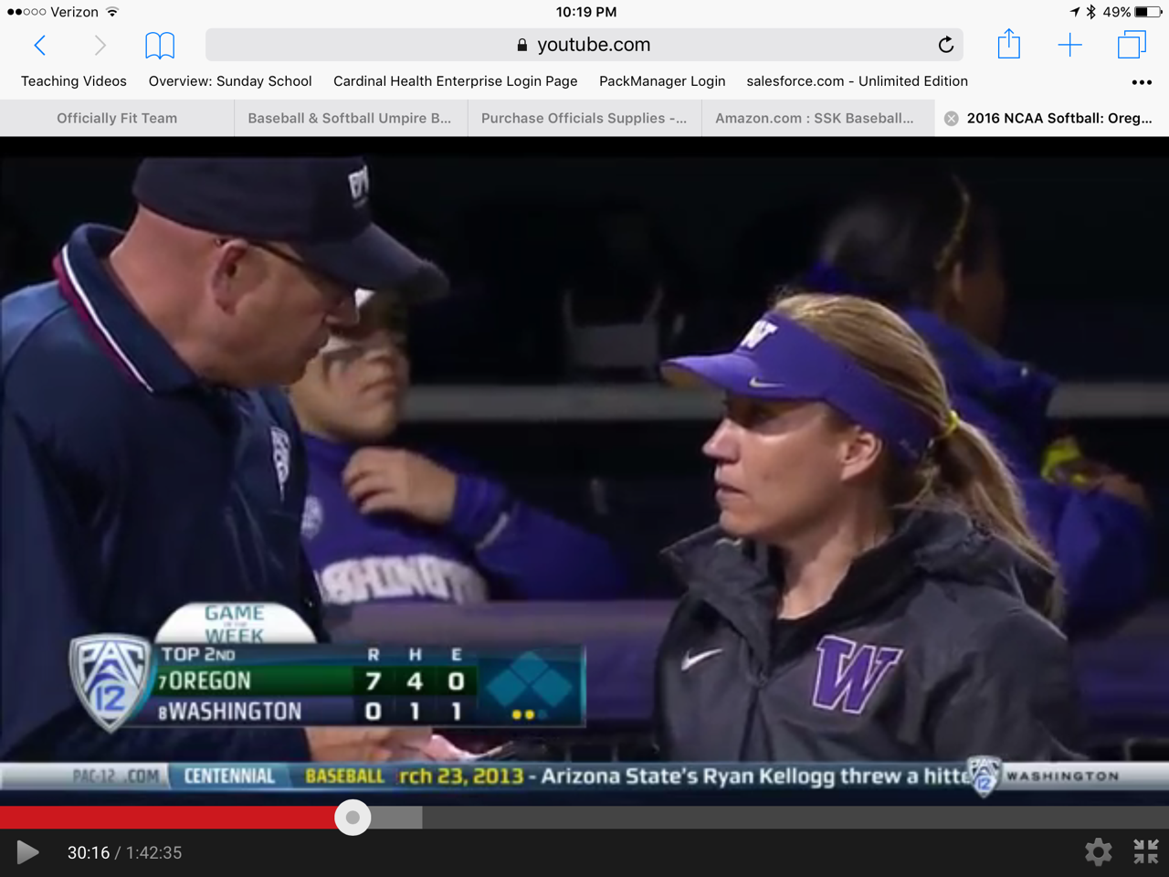
“Seeing Eye To Eye?”

Slide 5
Tonight’s Agenda Welcome and Recognition Welcome remarks Ted, Reed State Rules Presentation: Todd Foy Group Discussion: Casey Waite and Reed Clayton Coaches excused and Umpire training meeting to follow Game Management, Communication, Uniform, Director Open Position

Slide 6
Coaches Discussion
Third District Contract Assistance – Three Umpires
Game Management (Florida vs Alabama Video 1:58)
What to expect from the Umpires, Listen, either move on or give a warning
What are the Three P’s that should earn you an ejection?
Personal, Persistent, Profanity
How you can help your cause?
Ask a question that creates a doubt
What kind of warnings will we use? And when should we use it?
When we should go for help, and when we probably shouldn’t.
What you can do to get us to go for help?
Effective professional communication is the key

Slide 7
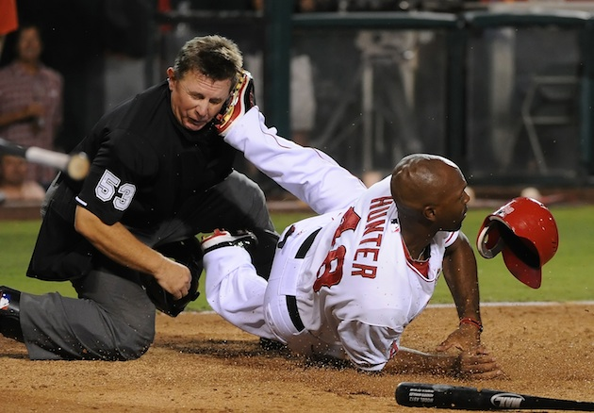
Sometimes, the job we do, can be “ugly”

Slide 8
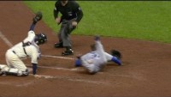
Sometimes the job we do, can be “a thing of beauty”

Slide 9
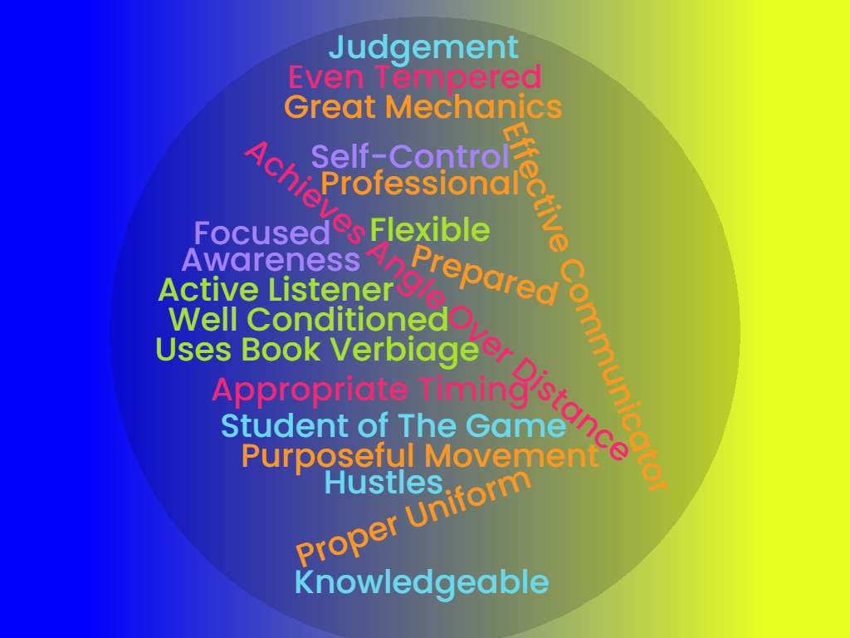
The Skills We Strive to Have, The Kind of Umpire We Strive to Be

Slide 10
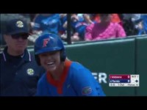
Game Management

